Slide 1
Learning about pygame
Javier ng

Slide 2
What is pygame?

Slide 3


What is pygame?

Slide 4

What is pygame?

Slide 5
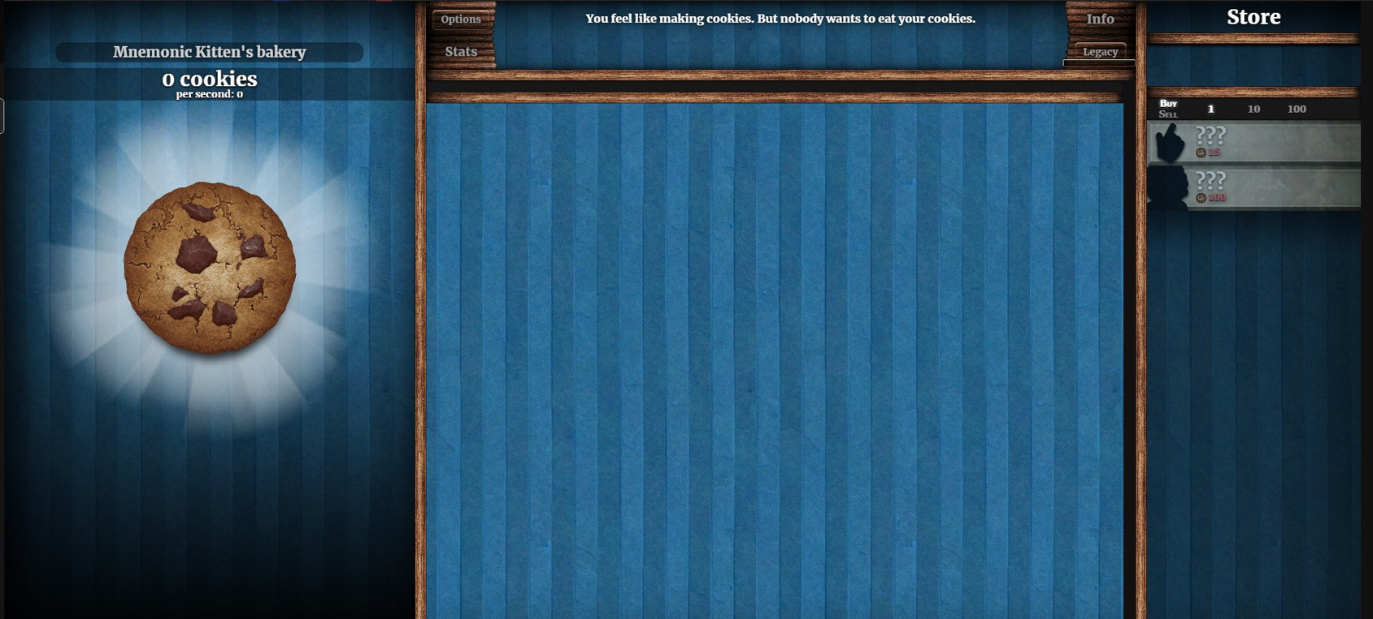

Slide 7
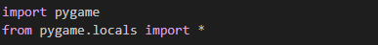
Making a screen

Slide 8
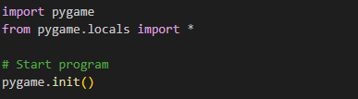
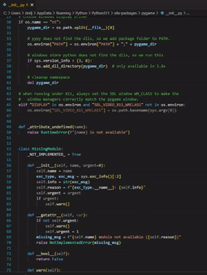
Making a screen

Slide 9
Making a screen

Slide 10
Making a screen

Slide 11
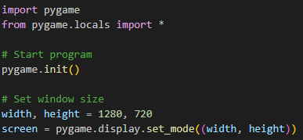
Making a screen

Slide 12
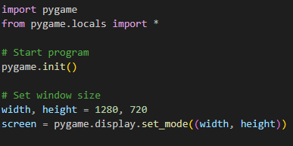
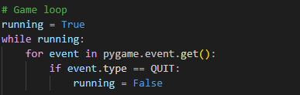
Making a screen

Slide 13
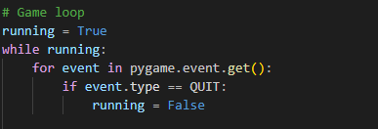
Making a screen

Slide 14
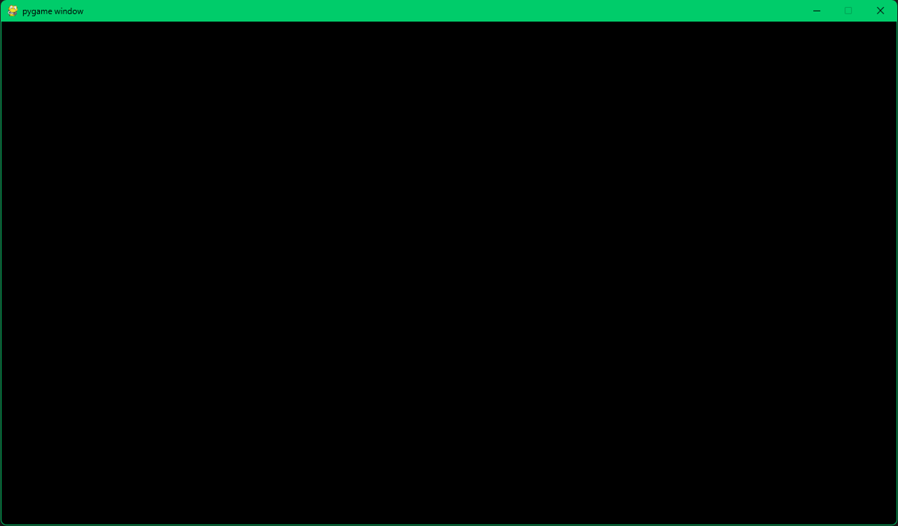
Making a screen

Slide 16


Slide 17

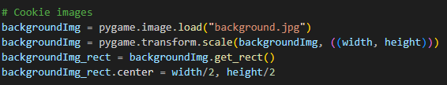
The background

Slide 18
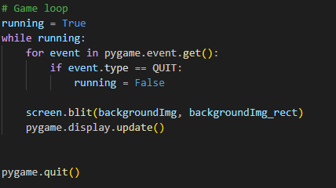
The background

Slide 19

The background

Slide 20
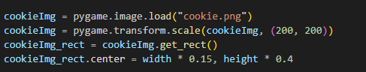

The cookie

Slide 21
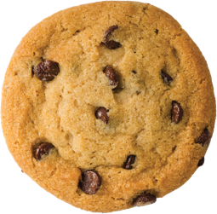
The cookie

Slide 22
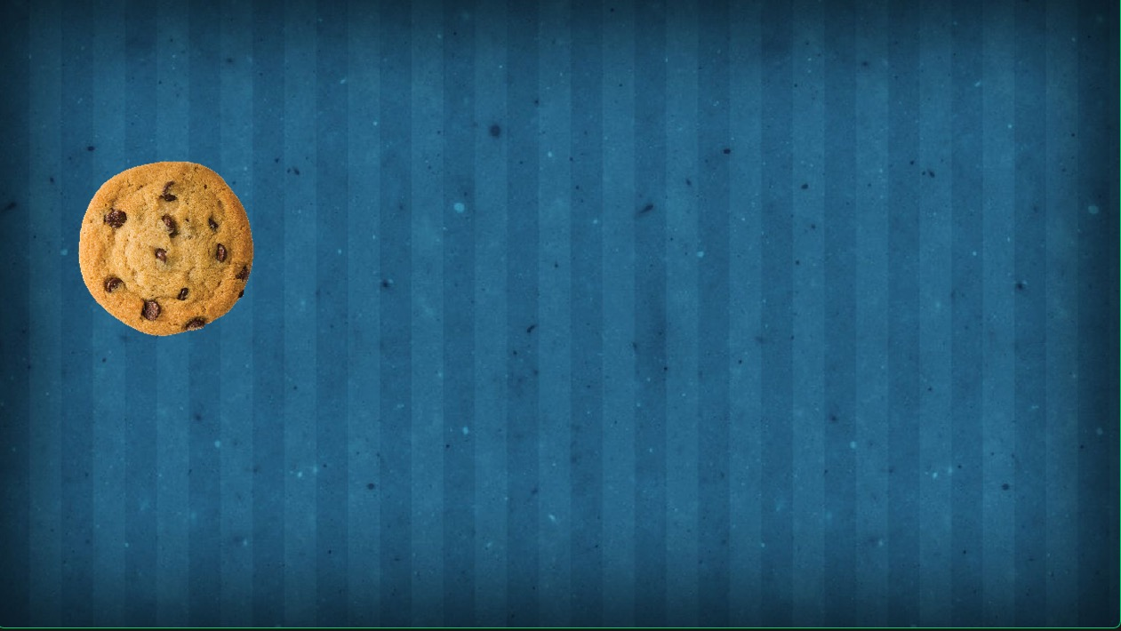
The cookie

Slide 24
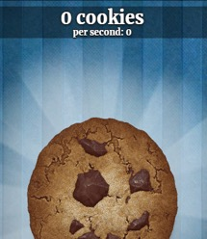
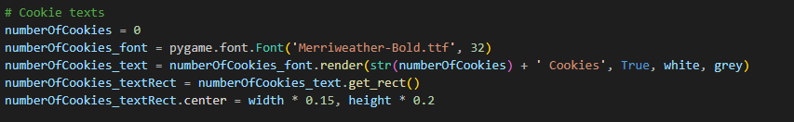
The number of cookies

Slide 25
The number of cookies
Aa Bb Cc Dd Ee Ff Gg Hh Ii Jj Kk Ll Mm Nn Oo Pp Qq Rr Ss Tt Uu Vv Ww Xx Yy Zz

Slide 26

The number of cookies

Slide 27

The Numbers

Slide 29

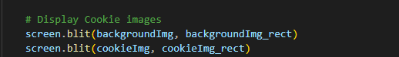
The clicking
Current game loop

Slide 30
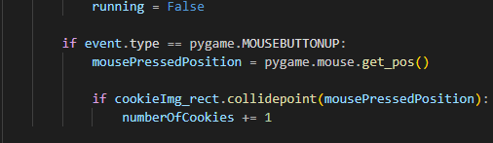

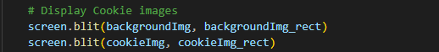
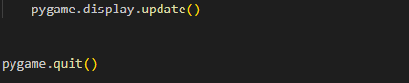
The clicking

Slide 31
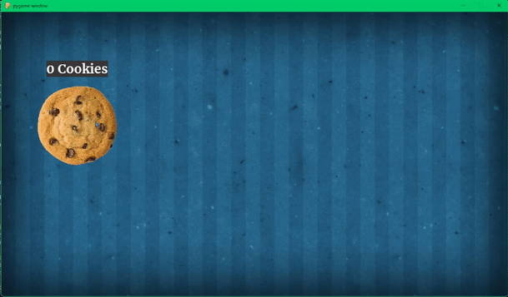
The Clicking

Slide 33
The upgrades
Current Mouse event

Slide 34
The upgrades

Slide 35
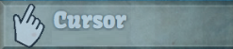
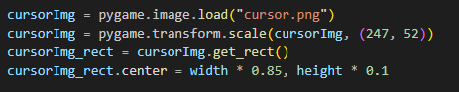
The upgrades

Slide 36
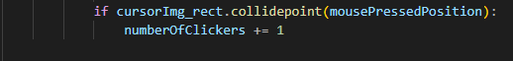
The upgrades

Slide 37
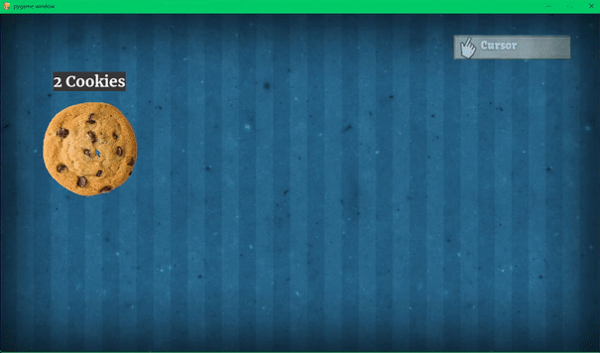
The Upgrades

Slide 38
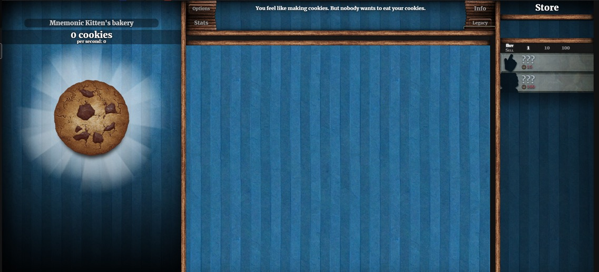
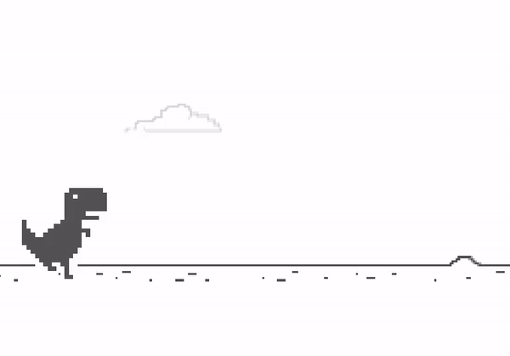
What else can I do?

Slide 39
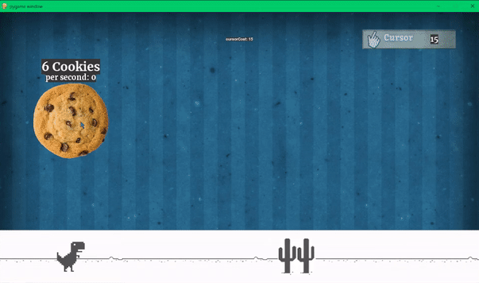
What else can I do?

Slide 40


Slide 41
Prompting pygame
John tan chong min

Slide 42
Get chatgpt to generate the game code for you!
Reference:
https://github.com/tanchongmin/TensorFlow-Implementations/tree/main/Fireball_Dodger
Prompt:
I would like to create a Python game in PyGame. The game's objective is to dodge fireballs coming from all four directions. You control a player that can move up, down, left, right. You have three lives and your aim is to collect cupcakes spawned at a random position. The score is based on the number of cupcakes you collect.

Slide 43
PyGame instructions
Things to note:
pygame (just do pip install pygame)
Place assets like images and audio in the same folder as the PyGame code
Run code and enjoy the game

Slide 44
Error handling
In order to correct any errors in the code, do this
Prompt:
<Game Code so far>
<Error Message from Python>
Generate me the corrected game code in a Python block.

